Slide 1
Fuzzy Rules

Slide 2
Fuzzy Rules
A fuzzy rule can be defined as a conditional statement in the form:
IF x is A
THEN y is B
where x and y are linguistic variables; and A and B are linguistic values determined by fuzzy sets
The range of possible values of a linguistic variable represents the universe of discourse of that variable.
For example, the universe of discourse of the linguistic variable speed might be the range between 0 and 220 km/h and may include such fuzzy subsets as very slow, slow, medium, fast, and very fast.

Slide 3
Fuzzy Rules
The difference between classical and fuzzy rules:
A classical IF-THEN rule uses binary logic:
Rule: 1
IF speed is > 100
THEN Min_stopping_Dist = 300
The variable speed can have any numerical value between 0 and 220 km/h, and stopping_distance can take either value 300 or 40.
In other words, classical rules are expressed in the black-and-white language of Boolean logic.
Rule: 2
IF speed is < 40
THEN Max_stopping_distance = 40

Slide 4
Fuzzy Rules
We can also represent the stopping distance rules in a fuzzy form:
Rule: 1
IF speed is fast
THEN stopping_distance is long
In fuzzy rules, the linguistic variable speed also has the range (the universe of discourse) between 0 and 220 km/h, but this range includes fuzzy subsets, such as slow, medium and fast.
The universe of discourse of the linguistic variable stopping_distance can be between 0 and 300m and may include such fuzzy subsets as short, medium and long.
Rule: 2
IF speed is slow
THEN stopping_distance is short

Slide 5
Fuzzy Rules
The output of a fuzzy membership function is a number x
0 <= x <= 1
So how can we combine these outputs in rules?
e.g. In Boolean logic
A AND B = 1 iff
A = 1 and B = 1
otherwise it is 0

Slide 6
Fuzzy Set Logic
In fuzzy logic A and B can have any value between 0 and 1
Let m(x) be the fuzzy membership function
Conjunction
m(A ∧ B) = min( m(A), m(B) )
e.g. Height is short and weight is heavy
Disjunction
m(A∨B) = max( m(A), m(B) )
e.g. Height is short or weight is heavy
Negation (the compliment)
m(not A) = 1 – m(A)

Slide 7
Fuzzy Set Logic
Other rules are also possible but the above are easy to calculate
e.g.
m(A XOR B) = min(m(A), 1 - m(B))
also
m(A XOR B) = min(1 - m(A), m(B))

Slide 8
Defuzzification
In a Boolean rule: output is either 1 or 0
If (A OR B) then C
If A OR B evaluates to 1 then do action C
Otherwise do NOT do action C
In Fuzzy logic output can be between 0 and 1
But when do we do C?
There are a number of approaches…

Slide 9

Defuzzification
Evaluate all rules
Fire the rule with the highest activation
This is the easiest to do!
e.g. Assume we have three rules
One with action flee (A)
One with action do nothing (B)
One with action attack (C)
Feed our variable into the membership functions and pick the highest subset value.
A B C

Slide 10
Defuzzification
Blending based on membership
Use a singleton output function that converts into an action
If
A fires with strength 0.6
B fires with strength 0.2
C fires with strength 0
then
Assign speeds to each action
Flee = -10
Stay = 1
Attack = +10
A B C

Slide 11
Defuzzification
Output is the weighted average:
((0.6 * -10)+(0.2 * 1)+(0 * 10)) / (0.6 + 0.2 + 0)
= -7.25
Output is speed of -7.25 == Flee-fastish!
A B C

Slide 12
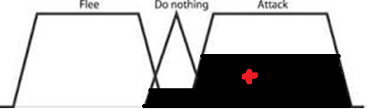
Defuzzification
Centre of Gravity (aka centroid of area)
Makes use of all set membership values rather than just the largest
Each membership function cropped at the membership value for its subset
Centre of mass of the cropped regions is the output value

Slide 13
Hedges
When communicating in a natural language, a form of mitigating device is commonly used to weaken or strengthen the impact of a statement.
A linguistic variable may have a fuzzy set qualifier associated with it, called a hedge.
Hedges include adverbs such as very, somewhat, quite, more or less and slightly.
IF height is very tall
THEN weight is very heavy
IF speed is very slow
THEN stopping_distance is very short

Slide 14
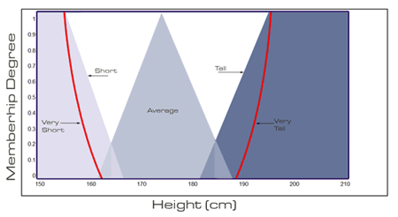
Hedges
Hedges are terms that modify the shape of fuzzy sets.
Referred to as concentration and dilation e.g. m(x)² and m(x)^{1/2}
They are not necessary
They generally result in a non-linear membership output value

